Slide 1

Email Spam Detection Using Machine Learning
Charles Ohene Apaw
Institute Of Data
02/11/2024

Slide 2
Introduction and Business Problem
What is Email Spam?
Unsolicited, irrelevant messages sent in bulk to large numbers of users.
Effects of spam on Business:
Lost Productivity 🕒: Employees waste time filtering out spam.
Security Risks 🛡️: Spam often includes phishing and malicious content.
Operational Costs 💵: Increased load on email servers and need for security measures.
Impact of Spam on Business:
$20.5 billion lost annually by businesses worldwide
$1,934 per employee on average in productivity and technical expenses
Spam email makes up 56.5% of all emails sent
Business Problem:
How can we accurately detect and classify spam emails to improve organizational productivity and security?
Notes:
Source: Radicati Group and Nucleus Research.

Slide 3
Industry Relevance & Key Stakeholders
Industry Relevance:
💰 Finance:
Protects sensitive financial data from phishing and fraud.
🩺 Healthcare:
Ensures patient privacy and regulatory compliance.
💼 General Business:
Maintains productivity and secures intellectual property.
Key Stakeholders:
Primary Stakeholders:
🛡️ IT & Cybersecurity Teams: Oversee spam detection systems and data security.
💼 Company Executives: Ensure alignment with organizational security goals.
Secondary Stakeholders:
👨‍💼 Employees: Benefit from reduced exposure to phishing attempts, saving time.
👥 Customers: Experience better service continuity and data protection.

Slide 4
Data Collection & Preparation
Dataset Overview:
Source: Dataset was developed by Balaka Biswas and sourced from Kaggle with 5,172 emails.
Columns: 3,002 total columns.
Email No.: First column anonymizes each email for privacy.
Target Variable: Last column labeled as Prediction (0 for non-spam, 1 for spam).
Word Frequencies: Remaining 3,000 columns represent the most common words in the emails.
Data Preparation Steps:
Checked for Missing Values: No missing values found.
Dropped Unnecessary Columns: Focused only on relevant columns.
Removed Duplicates: Identified and removed 541 duplicate emails.
Handled Class Imbalance: Addressed imbalance of 70% non-spam vs. 30% spam.

Slide 5
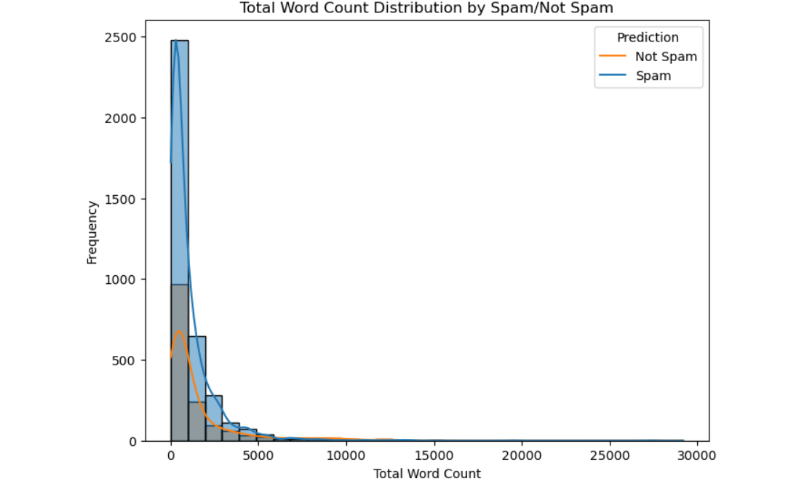
Total Word Count Distribution by Spam and Non-Spam Emails

Slide 6
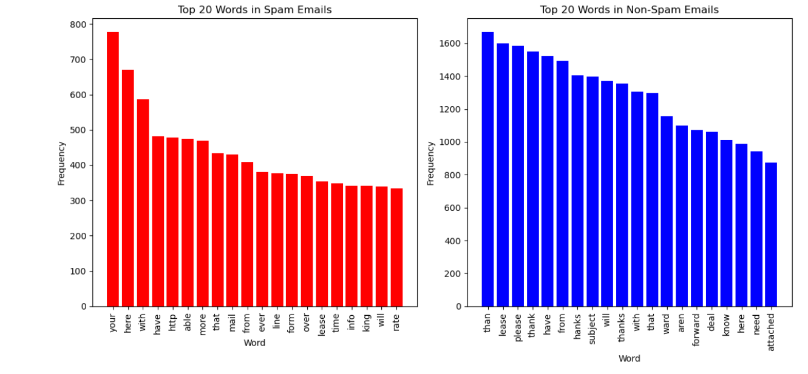
Top 20 Words in Spam vs. Non-Spam Emails

Slide 7
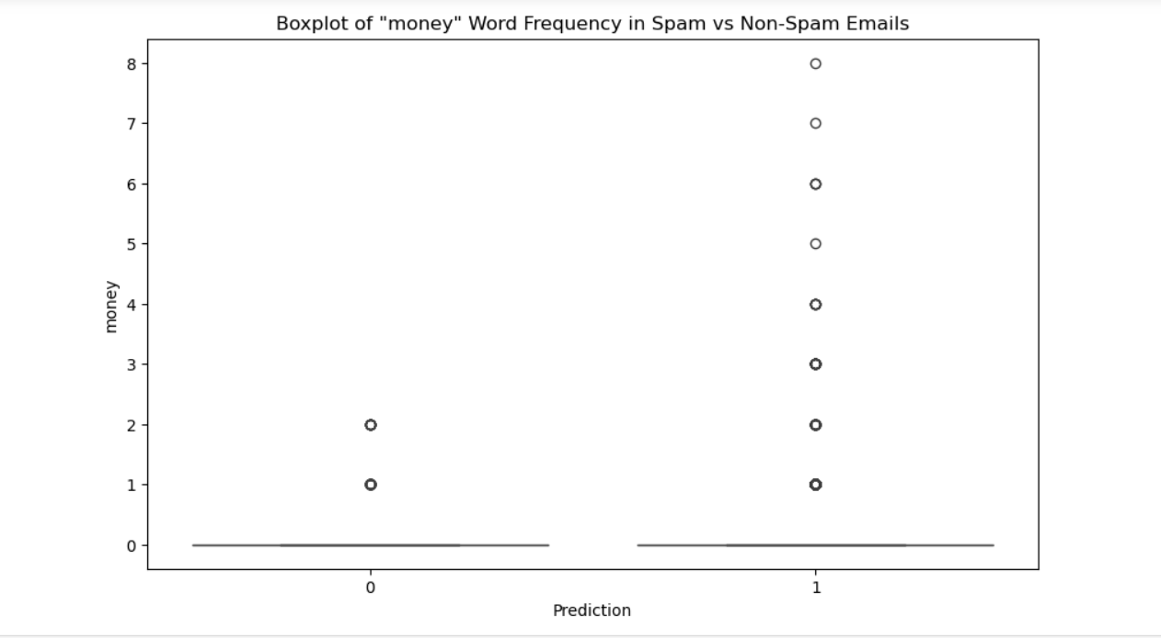
Boxplot Analysis of the Word "Money" in Spam vs. Non-Spam Emails

Slide 8
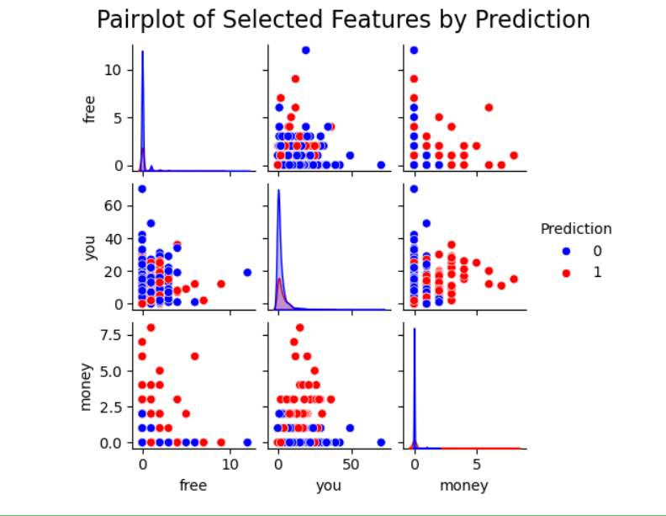
Pairplot Analysis of Key Words by Email Classification

Slide 9
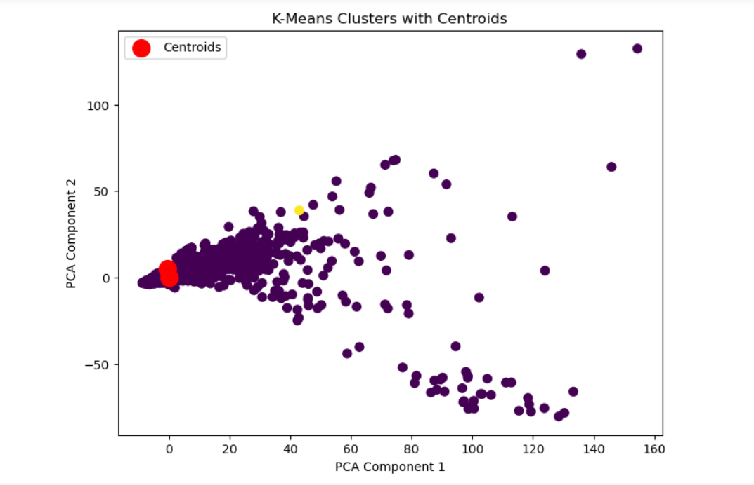
K-Means Clustering with Feature Scaling
Feature scaling ensures balanced clustering.
Two distinct clusters identified for potential spam and non-spam emails.
Plot created using PCA for clear visual representation.

Slide 10

Train-Test Split and Final Scaling
Full Dataset
80% Training Data
20% Testing data

Slide 11
Supervised Models and Evaluation Metrics
Model Selection:
Logistic Regression with Class Weights: Adds importance to the minority class (spam) for balanced learning.
Balanced Random Forest: Combines multiple balanced decision trees, improving performance on imbalanced datasets.
XGBoost: A powerful boosting algorithm known for handling imbalanced data effectively with high accuracy.
Evaluation Metrics:
Accuracy: Measures the overall correctness of the model.
Precision: Focuses on how well we avoid false positives (labeling non-spam as spam).
Recall: Measures the model's ability to identify all actual spam emails.
F1-Score: Balances precision and recall, giving a holistic view of performance.
AUC (Area Under Curve): Reflects the model's performance across all classification thresholds.

Slide 12
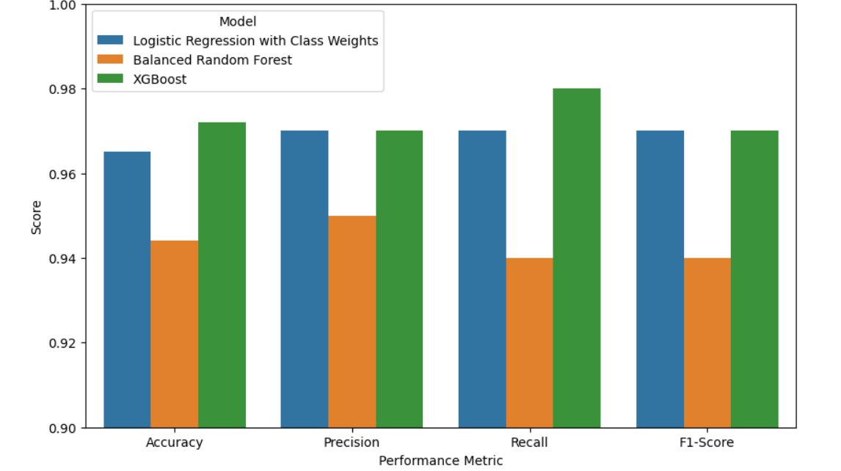
Model Performance Comparison

Slide 13
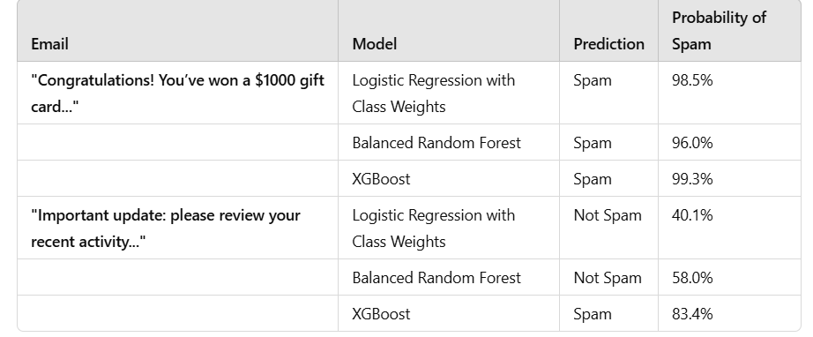
Model Predictions on Dummy Emails

Slide 14
Error Analysis and Insights
Common Misclassifications:
High language overlap in spam and non-spam emails.
Models occasionally fail with ambiguous emails.
Potential Challenges:
Dataset limitations: Only word counts without contextual data.
Risk of data leakage was considered and mitigated.
Recommendations:
Consider adding metadata (e.g., subject line analysis).
Explore using more contextual NLP features.

Slide 15
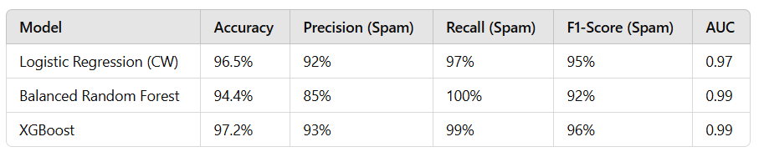
Results and Impact
💰 Cost Savings: Implementing this model can help businesses save approximately $20.5 billion annually and $1,934 per employee by reducing productivity loss and technical support needs.
🏦 Finance: Enhanced protection against phishing and data breaches, safeguarding client data and maintaining trust.
🩺 Healthcare: Strengthened secure communication and data protection, ensuring patient confidentiality and uninterrupted operations.

Slide 16
Future Work and Improvements
Data Enhancement: Explore more comprehensive datasets, including real email content and headers.
Feature Engineering: Incorporate contextual NLP features like named entities and topics.
Model Tuning: Further optimize hyperparameters for better performance.
Diverse Algorithms: Test with additional models such as LSTM for sequence analysis.
Deployment: Plan for model integration via APIs or lightweight applications.

Slide 17

Thank you ! Any Question?
Notes:
https://www.linkedin.com/in/charles-ohene-apaw-381925a6

